Slide 1
Software Evolution and Maintenance
A Practitioner’s Approach
Chapter 7
Refactoring
Notes:
Handouts
------------------------------------------------------------------
------------------------------------------------------------------
-------------------------------------------------------------------
--------------------------------------------------------------------

Slide 2
Outline of the Chapter
7.1 General Idea
7.2 Activities in a Refactoring Process
7.3 Initial Work on Software Restructuring
7.4 Factors Influencing Software Structure
7.5 Restructuring Techniques
7.6 Summary
Notes:
Handouts

Slide 3
7.1 General Idea
Developers continuously modify, enhance and adapt software.
As software evolves and strays away from its original design, three things happen.
  Decreased understandability
  Decreased reliability
  Increased maintenance cost
Decreased understandability is due to
  Increased complexity of code
  Out-of-date documentation
  Code not conforming to standards
Software restructuring is informally stated as the modifications of software to make it
  easier to understand;
  easier to change;
  easier to change its documentation;
  less susceptible to faults when changes are made to it.
Notes:
Handouts

Slide 4
7.1 General Idea
A higher level goal of restructuring is to increase the software value
  external software value: fewer faults in software is seen to be better by customers
  internal software value: a well-structured system is less expensive to maintain
Simple examples of restructuring
  Pretty printing
  Meaningful names for variables
  One statement per line of source code
Developers and managers need to be aware of restructuring for the following reasons
  better understandability
  keep pace with new structures
  better reliability
  longer lifetime
  automated analysis
Notes:
Handouts

Slide 5
7.1 General Idea
Characteristics of restructuring and refactoring
  The objective of restructuring and refactoring is to improve the internal and external values of software.
  Restructuring preserves the external behavior of the original program.
  Restructuring can be performed without adding new requirements.
  Restructuring generally produces a program in the same language.
    Example: a C program is restructured into another C program.
Notes:
Handouts

Slide 6
7.2 Activities in a Refactoring Process
To restructure a software system, one follows a process with well defined activities.
  Identify what to refactor.
  Determine which refactoring to apply.
  Ensure that refactoring preserves the software’s behavior.
  Apply the refactoring to the chosen entities.
  Evaluate the impacts of the refactoring.
  Maintain consistency.
Notes:
Handouts

Slide 7
7.2.1 Identify what to refactor
The programmer identifies what to refactor from a set of high-level software artifacts.
  source code;
  design documents; and
  requirements documents.
Next, focus on specific portions of the chosen artifact for refactoring.
  Specific modules, functions, classes, methods, and data can be identified for refactoring.
The concept of code smell is applied to source code to detect what should be refactored.
A code smell is any symptom in source code that possibly indicates a deeper problem.
Examples of code smell are:
  duplicate code;
  long parameter list;
  long methods;
  large classes;
  message chain.
Notes:
Handouts

Slide 8
7.2.2 Determine which refactorings to apply
Referring to Figure 7.1, some refactoring's are
  R1: Rename method print to process in class PrintServer.
  R2: Rename method print to process in class FileServer. (R1 and R2 are to be done together.)
  R3: Create a superclass Server from PrintServer and FileServer.
  R4: Pull up method accept from PrintServer and FileServer to the superclass Server.
  R5: Move method accept from PrintServer to class Packet, so that data packets themselves will decide what actions to take.
  R6: Move method accept from FileServer to Packet.
  R7: Encapsulate field receiver in Packet so that another class cannot directly access this field.
  R8: Add parameter p of type Packet to method print in PrintServer to print the contents of a packet.
  R9: Add parameter p of type Packet to method save in class FileServer so that the contents of a packet can be printed.
Notes:
Handouts

Slide 9
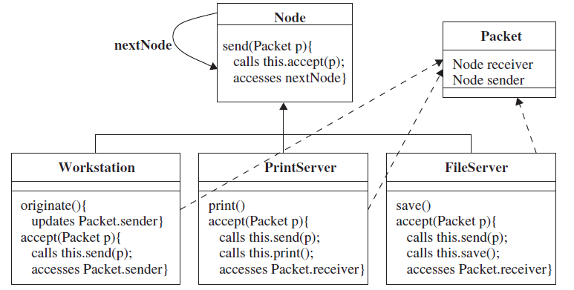
7.2.2 Determine which refactorings to apply.
Figure 7.1: Class diagram of a Local Area Network (LAN) simulator [6]
(©[2007] Springer).

Slide 10
7.2.2 Determine which refactorings to apply
R1—R9 indicate that a large number of refactoring can be identified even for a small system.
A subset of the entire set of refactoring need to be carefully chosen because of the following reasons.
  Some refactoring must be applied together.
    Example: R1 and R2 are to be applied together.
  Some refactoring must be applied in certain orders.
    Example: R1 and R2 must precede R3.
  Some refactoring can be individually applied, but they must follow an order if applied together.
    Example: R1 and R8 can be applied in isolation. However, if both of them are to be applied, then R1 must occur before R8.
  Some refactoring are mutually exclusive.
    Example: R4 and R6 are mutually exclusive.
Notes:
Handouts

Slide 11
7.2.3 Ensure that refactoring preserves the software’s behavior.
  Two pragmatic ways of showing that refactoring preserves the software’s behavior.
  Testing
    Exhaustively test the software before and after applying refactoring, and compare the observed behavior on a test-by-test basis.
  Verification of preservation of call sequence
    Ensure that the sequence(s) of method calls are preserved in the refactored program.
Notes:
Handouts

Slide 12
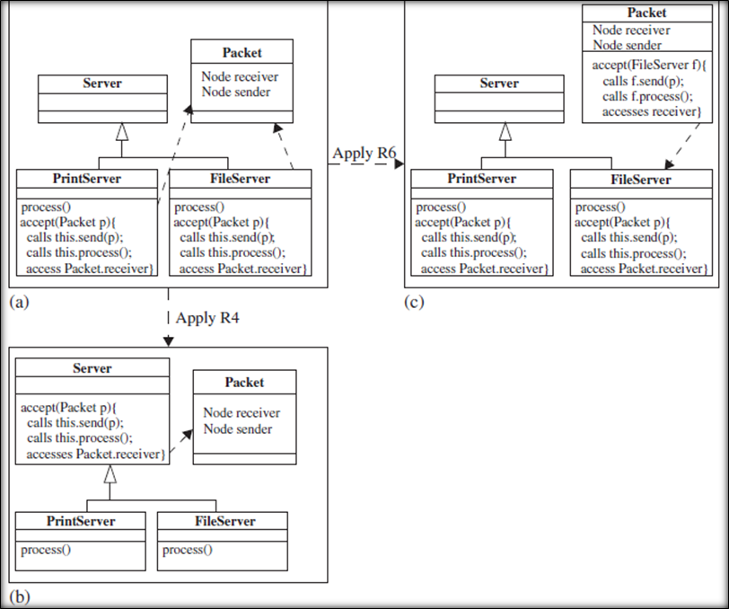
7.2.4 Apply the refactorings to chosen entities
The class diagram of Fig. 7.2(a) has been obtained from Fig. 7.1 by
  focusing on the classes FileServer, PrintServer, and Packet; and
  applying refactoring R1, R2, and R3.
Figure 7.2: Applications of two refactorings [6] (© [2007] Springer).
Notes:
Handouts

Slide 13
7.2.5 Evaluate the impacts of the refactoring
Rather than evaluate the impacts after applying refactorings, one selects refactoring such that the program after refactoring possesses better quality attributes.
The concept of soft-goal graph help select refactoring's.
Example: A soft-goal graph for quality attribute (maintainability) is a hierarchical graph rooted at the desired change in the attribute, for example, high maintainability.
The internal nodes represent successive refinements of the attribute and are basically the soft goals.
The leaf nodes represent refactoring transformations which contribute positively/negatively to soft-goals which appear above them in the hierarchy.
A partial example of a soft goal graph with one leaf node, namely, Move, has been illustrated in Fig. 7.3.
Notes:
Handouts

Slide 14
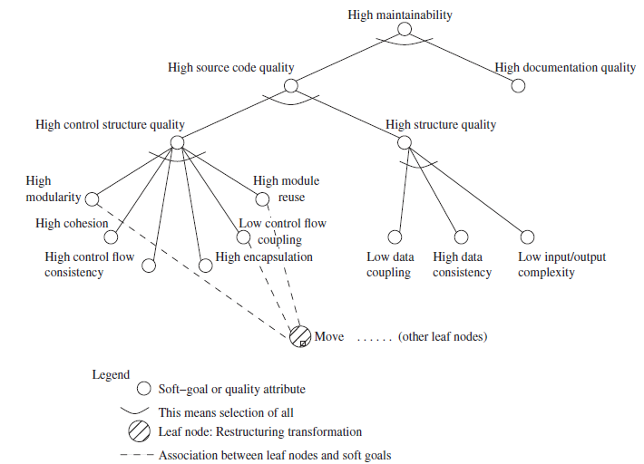
7.2.6 Maintain consistency
The dotted lines between the leaf node Move and three soft goals – High Modularity, High Module Reuse, and Low Control Flow Coupling imply that the Move transformation impacts those three soft goals.
Figure 7.3: An example of a soft goal graph for maintainability,
with one leaf node [11] (© [2002] IEEE).
Notes:
Handouts

Slide 15
7.3 Initial Work on Software Restructuring
Software restructuring dates back to the mid 1960s, as soon as programs were written in Fortran.
Notes:
Handouts

Slide 16
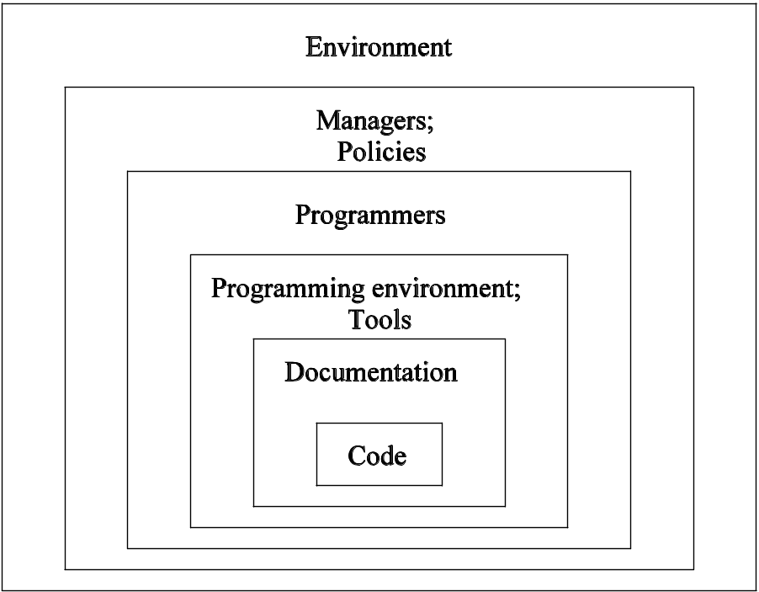
7.4 Factors Influencing Software Structure
Software structure is a set of attributes of the software such that the programmer gets a good understanding of software.
Any factor that can influence the state of software or the programmer’s perception might influence software structure.
One view of the factors that influence software structure has been shown in Fig. 7.9.
  Code
  Documentation
  Tools
  Programmers
  Managers and policies
  Environment
Figure 7.9: Factors which can influence software structure [2]
(© [1989] IEEE).
Notes:
Handouts

Slide 17
7.5 Restructuring Techniques
Restructuring techniques
  Those were developed in the mid-70s, before object-oriented programming.
  The techniques are applied at different levels of abstractions.
Example of restructuring techniques
  Elimination-of-goto Approach
  Localization and Information Hiding Approach
  System Sandwich Approach
  Clustering Approach
  Program Slicing Approach
Notes:
Handouts

Slide 18
7.5.1&7.5.2 Restructuring Techniques
1- Elimination-of-goto Approach
  Before the onset of structured programming, much code was written in the ‘70s with goto statements.
  Structured programming puts emphasis on the following control constructs: for, while, until, and, if-then-else.
2- Localization and Information Hiding Approach
  Localization
    It is a process of collecting the logically related computational resources in one physical module.
      Functions, procedures, operations, and data types are computational resources.
    By localizing computational resources into separate modules, programmers can restructure a program into a loosely coupled system of sufficiently independent modules.

Slide 19
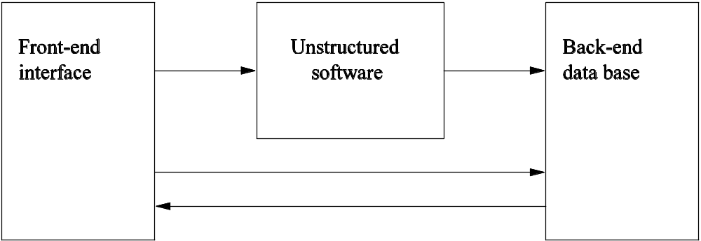
7.5.3 Restructuring Techniques
3- System Sandwich Approach
  This approach is applied to those software which cannot be restructured with any hope, but need to be retained for their outputs.
  As illustrated in Fig. 7.11, write a new front-end interface and a new back-end data base so that:
    it is easy to interface with the program; and
    the program’s outputs are recorded in a more structured way.
Figure 7.11: System sandwich approach to software restructuring.
The arrows represent the flow of data and/or commands.
Notes:
Handouts

Slide 20
7.5.4 Restructuring Techniques
4- Clustering Approach
  Software modularization is an important design step.
  A program can be remodularized in two ways.
    System level re-modularization
      This is a top-down approach.
      Partition the program into smaller modules, as illustrated in Fig. 7.12.
    Entity level re-modularization
      This is a bottom-up approach.
      Group a program’s entities to form larger modules.
Notes:
Handouts

Slide 21
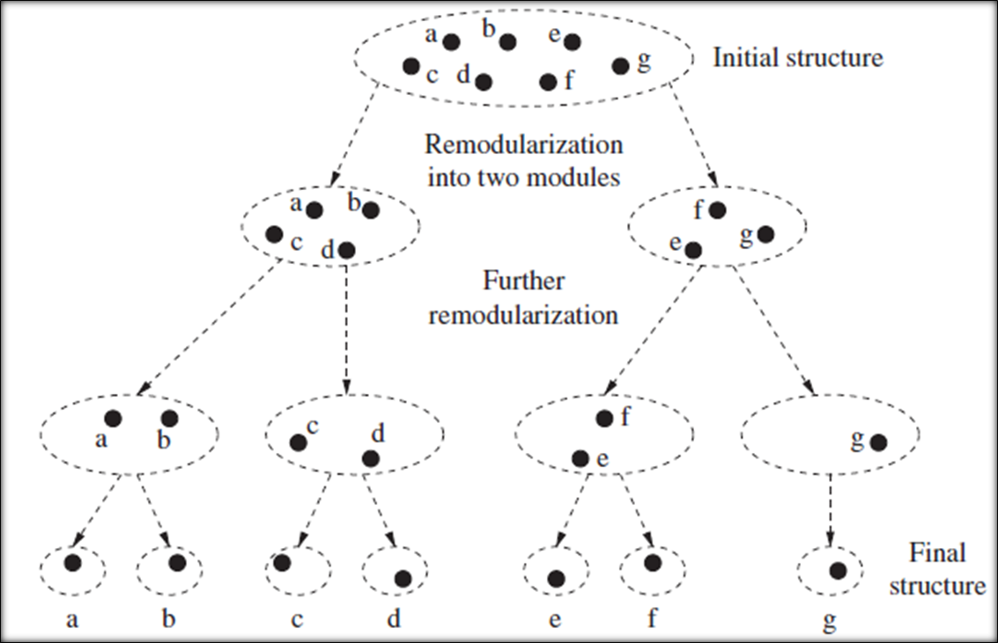
7.5.4 Restructuring Techniques
Figure 7.12: Illustration of system level remodularization.
Bullets represent low level entities.
Dotted shapes represent modules.
Arrows represent progression from one level to the next.

Slide 22
7.5.4 Restructuring Techniques
4- Clustering Approach (Contd.)
  Clustering algorithms: three broad techniques applied.
    Graph theoretical algorithms
    Construction algorithms
    Optimization algorithms (aka iterative and improvement algorithms)
    Hierarchical algorithms
      Divisive algorithms (See Figure 7.12)
      Agglomerative algorithms (See Figure 7.13)
    The clustering produced by a hierarchical algorithm can be visualized in a dendogram.
      The dendogram representation of the hierarchy in Fig. 12 has been shown in Fig. 7.14.
Notes:
Handouts

Slide 23
7.5.4 Restructuring Techniques
4- Clustering Approach (Contd.)
  The general structure of an agglomerative algorithm
IF there are N entities, begin with N clusters such that each
cluster contains a unique entity.
Compute the similarities between the clusters.
2. WHILE there is more than a cluster
DO
Find the most similar pair of clusters and merge them into a single cluster.
Recompute the similarities between the clusters.
END
Notes:
Handouts

Slide 24

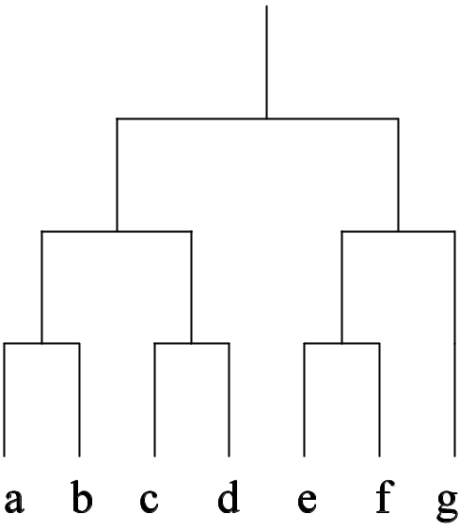
7.5.4 Restructuring Techniques
Figure 7.14: Dendogram
representation
of Fig. 7.12.
Figure 7.12: Illustration of system level remodularization.
Bullets represent low level entities.
Dotted shapes represent modules.
Arrows represent progression from one level
to the next.

Slide 25
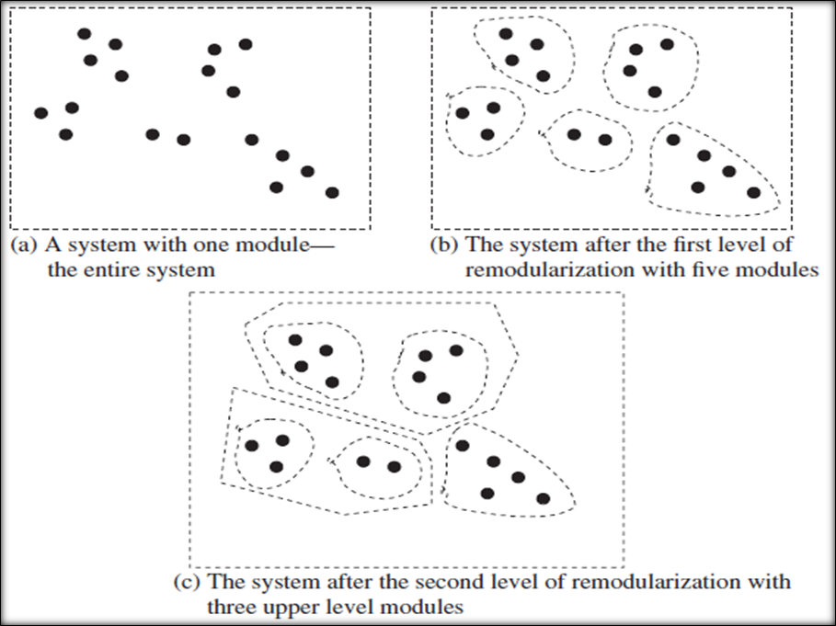
7.5.4 Restructuring Techniques
Figure 7.13: Illustration of entity level remodularization.
Bullets represent low level entities.
Dotted shapes represent modules.

Slide 26
7.6 Summary
General Idea
Activities in a Refactoring Process
Initial Work on Software Restructuring
Factors Influencing Software Structure
Restructuring Techniques
Notes:
Handouts

